Slide 1
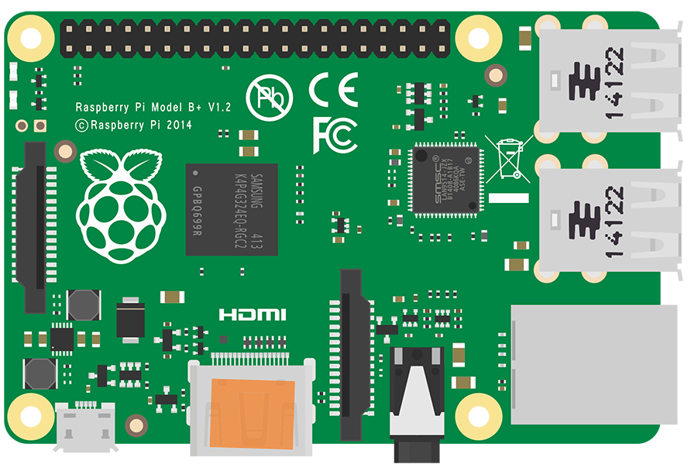

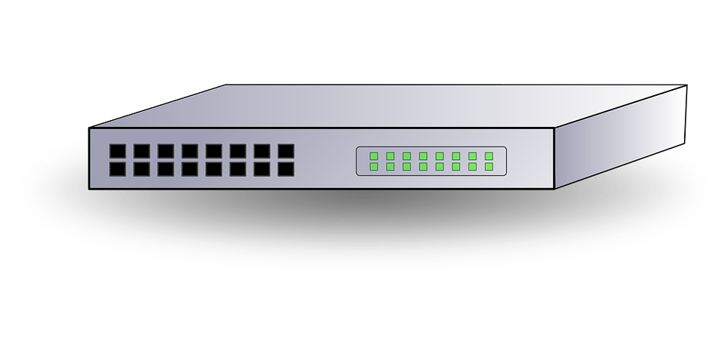
Network Switch
Node 1
Testbed Controller (TC)
AP / Router
Node 2
Testbed Controller (TC)
WiFi Test Network
Node 3
⁞
Control Network
Node N
Test Network

Slide 2

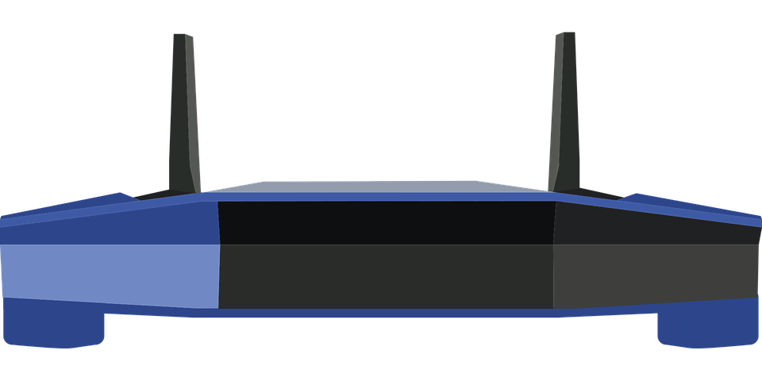
IP eth0: 10.1.1.101
IP wlan0: 192.168.Y.101
Test
Network
Client
IP: 10.1.1.X
TC
IP eth0: 10.1.1.102
IP wlan0: 192.168.Y.102
Switch
IP: 10.1.1.1
Client
WiFi
IP eth0: 10.1.1.103
IP wlan0: 192.168.Y.103
Access Point
IP: 192.168.Y.1
Control
Network
Client
IP eth1: 192.168.Y.201
(USB Adapter)
IP eth0: 10.1.1.104
Server

Slide 3
